Slide 1
Measurements in Science
Part II

Slide 2
Why Are Measurements Inexact?
Oddly enough, science often measures in the inexact.
The problem lies in the fact that every measuring device is in increments that can be divided an infinite number of times.
The measurer has to make a guess on what the last digit of the measurement is.
This guess is called an estimate.
It’s fine as long as it’s precise & accurate based upon the measuring tool.

Slide 3
A Few Conditions…
Measuring in science has particular conditions to consider.
Accuracy v. Precision
Limits of measurements in science
Always include zeroes in front of decimals
Always include units

Slide 4
1. Accuracy v. Precision
Needless to say, scientists attempt to be accurate and precise with their measurements.
Accuracy: How close to the ACTUAL value the measurement is.
This relates to the item being measured.
Precision: How EXACT measurements are.
This relates to reproducing the same measurement repeatedly
Also, dependent on the precision of the device doing the measuring.
Being accurate and precise in measurements is vital for reproducing experiments, delivering accurate information, being a trusted resource.

Slide 5
Precision vs. Accuracy
Accuracy:
How close to actual value the measurement is.
This describes the actual object being measured.
Precision:
How accurately you read the measuring device.
It describes how many significant figures you can read get from the DEVICE.

Slide 6
Checkpoint Question
If I am collecting data on the ages of students in my classes. This is the data I display. For each class…
What does the data show you?
A. good precision/good accuracy
B. good precision/poor accuracy
C. poor precision/ poor accuracy
D. poor precision/ good accuracy
Student | 1st period | 2nd period | 3rd period
1 | 13 | 28 | 4
2 | 14 | 27 | 35
3 | 15 | 31 | 18
4 | 14 | 29 | 28
Choice | A | B | C
1?
2?
3?

Slide 7
Measurements In Science Are Limited to the Tool Used
In order to deliver accurate, precise, and trustworthy measurements the scientist must be able to use quality measuring devices.
The best measuring device chosen of what’s available will allow a scientist to measure accurately and precisely.
Once the best device is chosen, the measurer is responsible for reading the device accurately and repetitively.
The limit to measuring in science therefore, is the device.
2. In scientific measurements, read all markings available and estimate the last unit…
Errors, discrepancies, and inconsistencies happen in real science.
That is okay, but you must work towards keeping the margin of error as low as possible.

Slide 8
3. Measurement “Grammar”
Whenever a measurement or calculation is less than zero you must include a zero in front of the decimal.
Example:
you measure the width of a pencil to be just under 1cm
you would need to write this measurement as: 0.7cm
Every measurement must include the unit!
Example: If you write 0.7 down as your answer, no one else knows if you meant 0.7cm, m, km, grams, pounds, or whatever else!
When taking measurements, read all the visible markings on the tool then ESTIMATE the last number to the nearest 0.5. This maximizes precision!
Example: Which is more precise measurement for the length (see arrow)?
675.5mm or
67.5cm

Slide 9
The Goal of Measuring…
In science, the goal is to be accurate and precise.
Why?
So the measurements can be trusted.

Slide 10
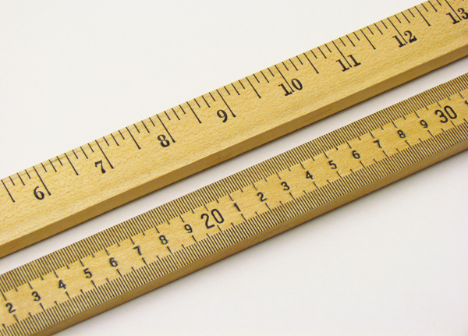
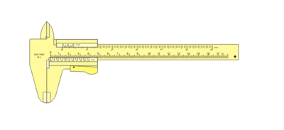
4a. Tools for Measurement: Length
Length is the distance between 2 points.
We use a Standard Ruler/ Meter Stick to measure length.
Pay attention to the side of the ruler you use.
One side is often Standard.
The side we want to use is the metric side where the numbers are much closer together.
Caliper
Standard
Metric
Micrometer

Slide 11
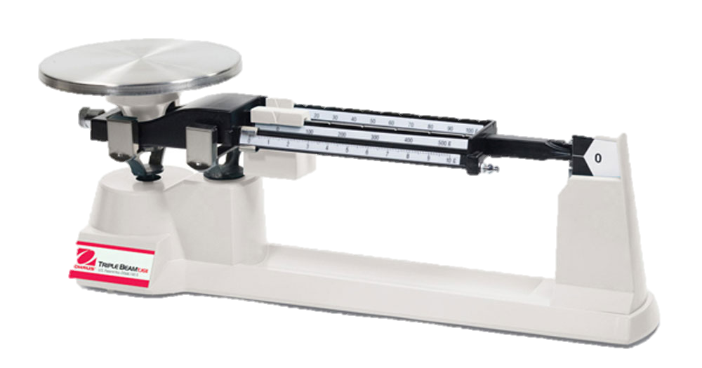
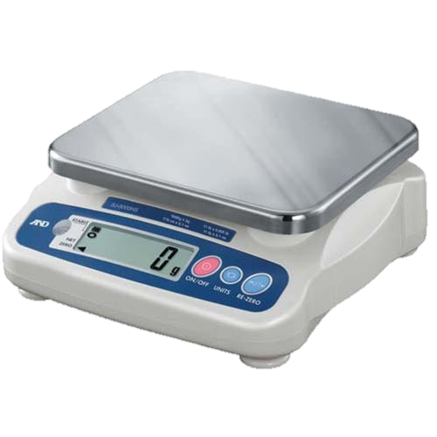
4b. Tools for Measurement: Mass
Mass is the measurement of how much matter a substance has.
It’s not weight, which is dependent on gravity.
Your mass on Earth is the same everywhere in the universe.
We use:
Triple Beam Balance
Digital Scale

Slide 12
Tools for Measurement: Volume
Volume is a measurement of how much space a substance takes up.
For regular 3-D shapes we can measure the sides and calculate the volume
For example, the volume of a cube is measured by multiplying the length x width x height.
For fluids, we use graduated cylinders or beaker-type containers to measure how much of the fluid we have.
For irregularly-shaped solids, we can add the substance to a known quantity of fluid and measure the displaced volume of fluid.

Slide 13
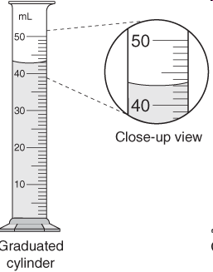
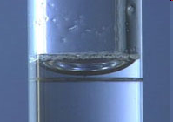
Measuring Volume
We will be using graduated cylinders to find the volume of liquids and other objects. Fluids create a meniscus.
Read the measurement based on the bottom of the meniscus or curve. When using a real cylinder, make sure you are eye-level with the level of the water.
What is the volume of water in the cylinder? _____mL
What causes the meniscus?
A concave meniscus occurs when the molecules of the liquid attract those of the container. The glass attracts the water and it sticks to the sides “climbing” up the glass in a way.
The sag in the middle is gravity pulling down on the water.
Top Image: http://www.tea.state.tx.us/student.assessment/resources/online/2006/grade8/science/images/20graphicaa.gif Bottom Image: http://morrisonlabs.com/meniscus.htm

Slide 14
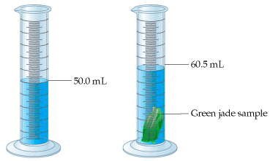
Measuring Solid Volume
We can measure the volume of regular object using the formula
length x width x height.
9 cm
__9cm__ X __8cm___ X __10cm___ = __720cm³___
8 cm
10 cm
We can measure the volume of irregular object using water displacement.
Amount of H₂O with object = 50.0mL
Amount of H₂O without object = 60.5mL Difference = Volume = 10.5mL

Slide 15
Tools for Measurement: Temperature
4d. Temperature is a comparative measurement of how hot or cold something is.
You’re probably used to using Fahrenheit, but in science we use the Kelvin (K), which is the same as Celsius (C) just starting 273 degrees Celsius colder.
Absolute zero = 0 Kelvin or -273°C
Freezing point of water = 273K or 0°C

Slide 16
Example
If you were measuring the width of the room, which device would you use?
A clock
Graduated cylinder
Triple beam balance
Meter stick
If you were measuring the mass of a book, which device would you use?
Triple beam balance
Meter stick
Graduated cylinder
A clock
If you were measuring the length of a book, which device would you use?
A meter stick
A stick (with no marking)
Another book
A piece of string

Slide 17
Taking Measurements Practice
You picked up several worksheets.
These are to practice reading the measuring devices you will use tomorrow.
Let’s go through an example on each page, then you will have the rest of class to finish up.
We will check on Monday
Remember, read all visible markings (even if they don’t have a number printed) on the measuring device then estimate the last number (which will make your numbers end with a zero or a 5).

